Slide 1


COURSE SLIDES · NON-WSQ COURSE
Autodesk Revit Architecture Masterclass
Course Code: C508
Conducted by Tertiary Infotech Academy Pte Ltd · UEN 201200696W
Version v1.0 · 1 October 2026
© 2026 Tertiary Infotech Academy Pte Ltd. All rights reserved. · www.tertiarycourses.com.sg

Slide 2
COURSE ADMINISTRATION
Welcome & Housekeeping
Autodesk Revit Architecture Masterclass · C508
© 2026 Tertiary Infotech Academy Pte Ltd
2

Slide 3
YOUR TRAINER · GENERAL
About the Trainer
NAME
____________________________________________
?
TITLE / DESIGNATION
____________________________________________
QUALIFICATIONS
____________________________________________
Your Trainer
AREAS OF EXPERTISE
____________________________________________
General Trainer template —
to be completed by the trainer
TRAINING & INDUSTRY EXPERIENCE
____________________________________________
CONTACT
____________________________________________
Autodesk Revit Architecture Masterclass · C508
© 2026 Tertiary Infotech Academy Pte Ltd
3

Slide 4
YOUR TRAINER
About the Trainer
ROLE
Principal Trainer, Tertiary Infotech Academy Pte Ltd
AA
EXPERTISE
BIM, CAD and digital design — Revit, AutoCAD, Fusion 360 and engineering software.
Dr Alfred Ang
DELIVERS
Courses on architecture drawing, BIM modeling, technical drawing and product design.
Principal Trainer
Tertiary Infotech Academy Pte Ltd
FOUNDER
Founder and lead instructor at Tertiary Infotech / Tertiary Courses.
Autodesk Revit Architecture Masterclass · C508
© 2026 Tertiary Infotech Academy Pte Ltd
4

Slide 5

ICE-BREAKER
Let's Know Each Other
• Your name and organisation / role.
• Your experience with CAD, BIM or architectural drafting (if any).
• What you want to design or document after this course.
Autodesk Revit Architecture Masterclass · C508
© 2026 Tertiary Infotech Academy Pte Ltd
5

Slide 6
HOUSEKEEPING
Ground Rules
Set your mobile phone to silent mode.
Participate actively — no question is too small.
1
2
Mutual respect: agree to disagree.
One conversation at a time.
3
4
Be punctual; return from breaks on time.
Attend both days in full.
5
6
Autodesk Revit Architecture Masterclass · C508
© 2026 Tertiary Infotech Academy Pte Ltd
6

Slide 7

LMS / TMS · COURSE PORTAL
Download Course Material
• Log in to the LMS/TMS portal: https://lms-tms.tertiaryinfotech.com
• Open your course under My Courses.
• Download the slides, Learner Guide and lab files from the Course Materials section.
• Keep them handy — refer to the slides and Learner Guide during the labs.
• Your certificate of completion is also issued on this portal after the course.
Autodesk Revit Architecture Masterclass · C508
© 2026 Tertiary Infotech Academy Pte Ltd
7

Slide 8
SCHEDULE
Lesson Plan — 2 Days, 7.5 hours/day
Day 1
Day 2 & timing
• Day 1 — Design Modeling & Building Elements
– Welcome · introductions · course overview
– Topic 1: Design Modeling in Revit (Labs 1–4)
– Topic 2: Part Lists for Modeling (Labs 5–8)
– Day 1 recap & Q&A
• Day 2 — Documentation & Specification
– Topic 3: Model Documentation (Labs 9–11)
– Topic 4: Design Specification (Lab 12)
– Course summary & feedback
• Daily timing
– 9:30am–5:30pm · 30-min lunch
Autodesk Revit Architecture Masterclass · C508
© 2026 Tertiary Infotech Academy Pte Ltd
8

Slide 9
REVIT & BIM FUNDAMENTALS
One Model, Every Drawing
Autodesk Revit Architecture Masterclass · C508
© 2026 Tertiary Infotech Academy Pte Ltd
9

Slide 10
THE BIG IDEA
What is Revit? What is BIM?
Design & documentation platform
Revit supports the design, drawings and schedules required for building information modeling (BIM).
Information when you need it
BIM delivers information about project design, scope, quantities and phases on demand.
1
2
One virtual building model
Every drawing sheet, 2D and 3D view and schedule is a presentation of the same model.
Coordinated everywhere
Revit collects information about the project and coordinates it across all other representations.
3
4
Autodesk Revit Architecture Masterclass · C508
© 2026 Tertiary Infotech Academy Pte Ltd
10

Slide 11
PARAMETRIC CHANGE ENGINE
Change it once — it changes everywhere.
The Revit parametric change engine automatically coordinates changes made anywhere: model views, drawing sheets, schedules, sections and plans.
Autodesk Revit Architecture Masterclass · C508
© 2026 Tertiary Infotech Academy Pte Ltd
11

Slide 12
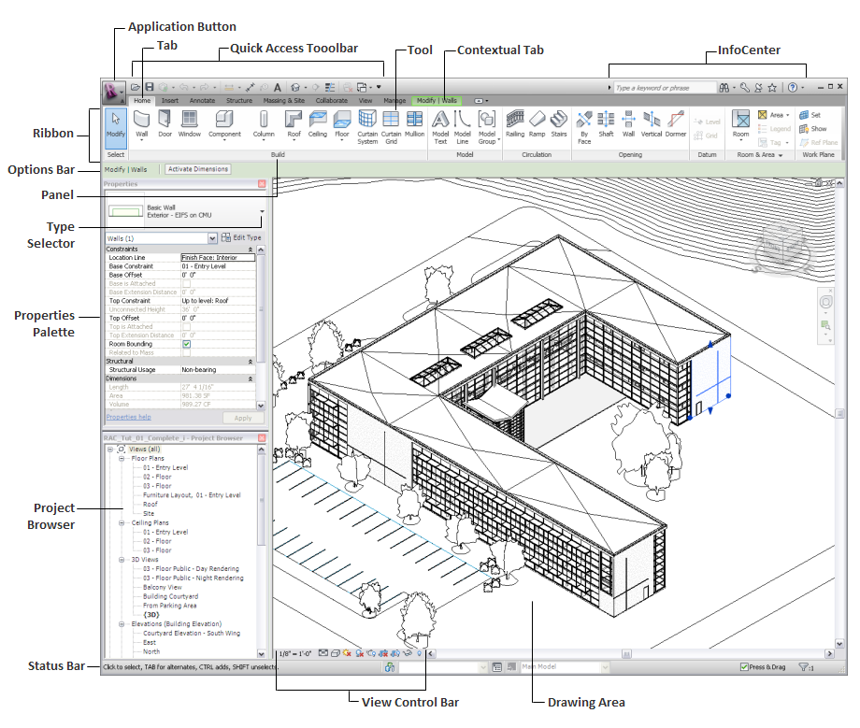
TOPIC 0 · GETTING AROUND
The Revit User Interface
• The interface is designed to simplify your workflow — a few clicks change it to suit how you work.
• The ribbon has 4 display settings; project views can be tiled or layered.
• Core parts: ribbon, Application Menu, Quick Access Toolbar, Project Browser, Properties palette, Options Bar, View Control Bar and status bar.
Autodesk Revit Architecture Masterclass · C508
© 2026 Tertiary Infotech Academy Pte Ltd
12

Slide 13
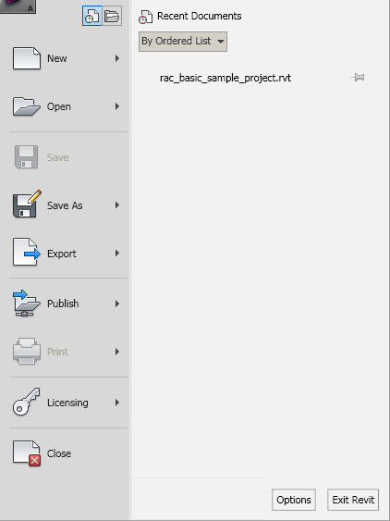
USER INTERFACE
Application Menu
• Access common file actions: New, Open, Save.
• Manage files with advanced tools such as Export and Publish.
• Click the File tab (application button) at the top-left to open it.
Autodesk Revit Architecture Masterclass · C508
© 2026 Tertiary Infotech Academy Pte Ltd
13

Slide 14
USER INTERFACE
Quick Access Toolbar
• A customisable strip of the tools you use most often.
• Right-click any ribbon tool ▸ Add to Quick Access Toolbar.
• Drop-down at the end: show/hide tools, or move the toolbar below the ribbon.
Autodesk Revit Architecture Masterclass · C508
© 2026 Tertiary Infotech Academy Pte Ltd
14

Slide 15
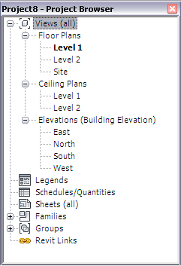
USER INTERFACE
Project Browser
• A logical hierarchy of all views, schedules, sheets, families, groups and linked models in the project.
• Expand/collapse each branch to reach lower-level items.
• Show it via View tab ▸ Windows panel ▸ User Interface ▸ Project Browser.
Autodesk Revit Architecture Masterclass · C508
© 2026 Tertiary Infotech Academy Pte Ltd
15

Slide 16
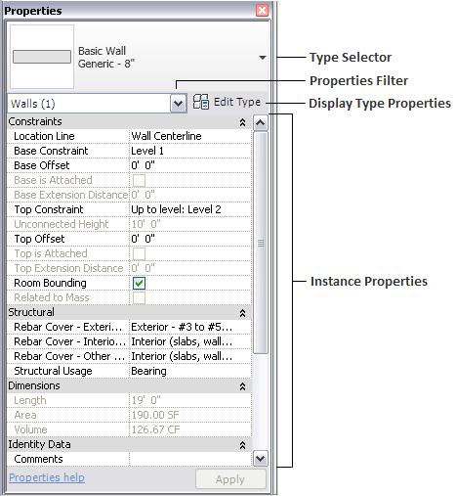
USER INTERFACE
Properties Palette
• A modeless dialog to view and modify the parameters that define each element's properties.
• Top: the Type Selector. Below: instance properties of the selection (or the view).
• Open it via View tab ▸ Windows panel ▸ User Interface ▸ Properties.
Autodesk Revit Architecture Masterclass · C508
© 2026 Tertiary Infotech Academy Pte Ltd
16

Slide 17
USER INTERFACE
Options Bar
• Sits below the ribbon; its contents change with the current tool or selected element.
• Sets tool options such as Level, Height, Location Line, Chain and Offset while you draw.
• Right-click it to dock at the bottom of the window, above the status bar.
Autodesk Revit Architecture Masterclass · C508
© 2026 Tertiary Infotech Academy Pte Ltd
17

Slide 18
USER INTERFACE
View Control Bar
• Quick access to functions that affect the current view.
• Scale · Detail Level · Visual Style · Sun Path · Shadows · Rendering dialog.
• Crop View · Show/Hide Crop Region · Temporary Hide/Isolate · Reveal Hidden Elements.
Autodesk Revit Architecture Masterclass · C508
© 2026 Tertiary Infotech Academy Pte Ltd
18

Slide 19
KNOW YOUR FILES
Revit File Types
RVT — project
The building model: geometry, views, sheets and schedules all live here.
RTE — project template
A starting point with preset units, levels, views and families.
1
2
RFA — loadable family
Doors, windows, furniture, tags and title blocks loaded into projects.
DWG / DXF — CAD data
AutoCAD drawings that can be linked or imported into the model.
3
4
Autodesk Revit Architecture Masterclass · C508
© 2026 Tertiary Infotech Academy Pte Ltd
19

Slide 20
01
TOPIC 01
Design Modeling in Revit
BIM & the Revit platform · User interface · Site design & toposurfaces · Massing · Materials · Rendering
Autodesk Revit Architecture Masterclass · C508
© 2026 Tertiary Infotech Academy Pte Ltd
20

Slide 21
TOPIC 01 · KEY CONCEPTS
Key Concepts — Design Modeling in Revit
BIM platform
Revit supports design, drawings and schedules for building information modeling — every sheet, view and schedule presents the same virtual building model.
Parametric change engine
A change made anywhere — model views, sheets, schedules, sections, plans — is coordinated automatically everywhere else.
1
2
Revit user interface
Ribbon, Application Menu, Quick Access Toolbar, Project Browser, Properties palette, Options Bar and View Control Bar.
Site design
Sketch a toposurface, then add property lines, a building pad, parking and site components; present it in 3D or rendered views.
3
4
Massing studies
Conceptual mass families and in-place masses let you study volumes, zoning and floor-area ratio before detailed modeling.
Materials & rendering
Materials control graphics, appearance, thermal and physical data; the Render tool produces photorealistic images of the model.
5
6
Autodesk Revit Architecture Masterclass · C508
© 2026 Tertiary Infotech Academy Pte Ltd
21

Slide 22
WHAT YOU'LL DO
Hands-On Labs — Design Modeling in Revit
Labs 1–2
Labs 3–4
—
• Create a Project and Add Levels
• Create a Terrain and Building Pad
• Create an In-Place Mass and Apply Materials
• Render a Photorealistic View
• —
Autodesk Revit Architecture Masterclass · C508
© 2026 Tertiary Infotech Academy Pte Ltd
22

Slide 23
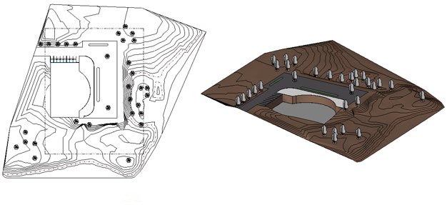
TOPIC 01 · SITE
Site Design
• Revit provides tools to lay out a complete site plan.
• Start by sketching a toposurface, then add property lines, a building pad, parking and site components.
• Present the site as a 3D view or render it for a realistic presentation.
Autodesk Revit Architecture Masterclass · C508
© 2026 Tertiary Infotech Academy Pte Ltd
23

Slide 24
TOPIC 01 · TERRAIN
Toposurface Toolset (Massing & Site tab)
Toposurface
Defines a topographical surface from points or imported data, in 3D or site-plan views.
Subregion
An area of the toposurface with its own properties, such as a different material.
1
2
Split / Merge Surface
Split a surface into two independent surfaces, or rejoin overlapping surfaces.
Graded Region
Grade the terrain: Revit demolishes the original surface and creates the proposed copy.
3
4
Building Pad
A closed-loop pad cut into the toposurface, with height offset, slope and openings.
Point elevation modes
Absolute Elevation places points at a set height; Relative to Surface edits an existing surface.
5
6
Autodesk Revit Architecture Masterclass · C508
© 2026 Tertiary Infotech Academy Pte Ltd
24

Slide 25
TOPIC 01 · MASSING
Massing — Two Ways to Study a Volume
Family-based
In-place
• Conceptual Mass Family
– Created outside the project and loaded in
– Reusable across projects and design options
– Best for often-used building volumes
• In-Place Mass
– Created inside the current project
– Specific to this project's context — not reusable
– Generate floors, roofs, curtain systems and walls from the mass
Autodesk Revit Architecture Masterclass · C508
© 2026 Tertiary Infotech Academy Pte Ltd
25

Slide 26
TOPIC 01 · MATERIALS (Manage ▸ Settings ▸ Materials)
What Materials Define
Graphics
Shading colour, surface pattern and cut pattern in non-rendered views.
Appearance
The photorealistic look used by the Realistic style and the renderer.
1
2
Thermal & Physical
Analytical data for energy and structural analysis.
How to apply
By category, by family, by element parameter, or by face with the Paint tool.
3
4
Autodesk Revit Architecture Masterclass · C508
© 2026 Tertiary Infotech Academy Pte Ltd
26

Slide 27
TOPIC 01 · PRESENTATION
Rendering Workflow
1
2
3
4
5
Open the 3D view
Render dialog
Quality & output
Lighting & background
Render & save
The view to render
View ▸ Graphics ▸ Render
Screen or Printer DPI
Sun, artificial, sky
Adjust exposure, export
TIP
Use the Realistic visual style for a live preview; render only when the view, materials and lighting are ready — high quality renders take time.
Autodesk Revit Architecture Masterclass · C508
© 2026 Tertiary Infotech Academy Pte Ltd
27

Slide 28
TOPIC 01 · HANDS-ON
Create a Project and Add Levels
LAB 1
Maps to: produce and visualise 2D/3D technical drawings using Revit (LO1)
Start a new Revit project from the architectural template, rename the default levels and add new levels that become the vertical datums for the whole building model.
YOU'LL BUILD
TOOLCHAIN
DONE WHEN
A Revit project with four named, correctly-elevated levels and their floor-plan views.
Revit · Architectural Template · Level tool
The Project Browser lists a floor plan for each new level, and the South elevation shows all four levels with the correct names and elevations. Compare with the completed LittleHouse.rvt model in the lab folder.
Autodesk Revit Architecture Masterclass · C508
© 2026 Tertiary Infotech Academy Pte Ltd
28

Slide 29
LAB 1 · PROCEDURE
Create a Project and Add Levels — Steps 1–3
Start Revit and create a new project from the architectural template.
1
File ▸ New ▸ Project ▸ Architectural Template ▸ OK
Open a building elevation so the levels are visible.
2
Project Browser ▸ Elevations (Building Elevation) ▸ South
Rename Level 1 to '01 - Entry Level'; accept renaming the corresponding views.
3
Double-click the level name ▸ type 01 - Entry Level ▸ Enter ▸ Yes
Autodesk Revit Architecture Masterclass · C508
© 2026 Tertiary Infotech Academy Pte Ltd
29

Slide 30
LAB 1 · PROCEDURE
Create a Project and Add Levels — Steps 4–6
Rename Level 2 to '02 - Upper Level' and set its elevation by clicking the blue elevation value.
4
Double-click the elevation value ▸ type 3000 ▸ Enter
Add a roof level by drawing a new level above the existing ones.
5
Architecture ▸ Datum ▸ Level ▸ draw left to right above 02
Add another level by offsetting from an existing one, then rename it.
6
Modify | Place Level ▸ Pick Lines ▸ Offset 3000 ▸ click level 02
Autodesk Revit Architecture Masterclass · C508
© 2026 Tertiary Infotech Academy Pte Ltd
30

Slide 31
LAB 1 · VERIFY
Create a Project and Add Levels
✅ Expected result
The Project Browser lists a floor plan for each new level, and the South elevation shows all four levels with the correct names and elevations. Compare with the completed LittleHouse.rvt model in the lab folder.
IF IT DOESN'T WORK
Tool is greyed out
Warning about closed loops
Can't select an element
Check the active view type — many tools only work in a plan, elevation or 3D view.
Open the sketch again and use Trim/Extend until the boundary is one closed loop.
Hover and press Tab to cycle the selection, and check the selection filters at the status bar.
Autodesk Revit Architecture Masterclass · C508
© 2026 Tertiary Infotech Academy Pte Ltd
31

Slide 32
TOPIC 01 · HANDS-ON
Create a Terrain and Building Pad
LAB 2
Maps to: produce and visualise 2D/3D technical drawings using Revit (LO1)
Add a toposurface to the building site by placing points at different elevations, then cut a building pad into the terrain based on the footprint of the foundation walls.
YOU'LL BUILD
TOOLCHAIN
DONE WHEN
A landscaped site with a graded toposurface, a grass material and a building pad ready for the model.
Revit · Toposurface · Building Pad · Section Box
The 3D view shows the terrain with a grass material, and the building pad cuts a level recess into the toposurface at the foundation walls.
Autodesk Revit Architecture Masterclass · C508
© 2026 Tertiary Infotech Academy Pte Ltd
32

Slide 33
LAB 2 · PROCEDURE
Create a Terrain and Building Pad — Steps 1–3
Open the site plan view of the project.
1
Project Browser ▸ Floor Plans ▸ Site
Start the Toposurface tool and place boundary points at elevation 0.
2
Massing & Site ▸ Model Site ▸ Toposurface ▸ Place Point ▸ Elevation 0
Raise the far points: change the elevation on the Options Bar as you place them.
3
Options Bar ▸ Elevation 900 ▸ click to place the back points
Autodesk Revit Architecture Masterclass · C508
© 2026 Tertiary Infotech Academy Pte Ltd
33

Slide 34
LAB 2 · PROCEDURE
Create a Terrain and Building Pad — Steps 4–6
Assign a grass material to the surface, then finish it.
4
Properties ▸ Material ▸ Grass ▸ Finish Surface
Sketch a building pad over the foundation footprint on the lower level.
5
Massing & Site ▸ Model Site ▸ Building Pad ▸ Pick Walls ▸ Finish
Frame the result in 3D with a section box to see the pad cutting the terrain.
6
3D view ▸ Properties ▸ Section Box ✓ ▸ drag the handles
Autodesk Revit Architecture Masterclass · C508
© 2026 Tertiary Infotech Academy Pte Ltd
34

Slide 35
LAB 2 · VERIFY
Create a Terrain and Building Pad
✅ Expected result
The 3D view shows the terrain with a grass material, and the building pad cuts a level recess into the toposurface at the foundation walls.
IF IT DOESN'T WORK
Tool is greyed out
Warning about closed loops
Can't select an element
Check the active view type — many tools only work in a plan, elevation or 3D view.
Open the sketch again and use Trim/Extend until the boundary is one closed loop.
Hover and press Tab to cycle the selection, and check the selection filters at the status bar.
Autodesk Revit Architecture Masterclass · C508
© 2026 Tertiary Infotech Academy Pte Ltd
35

Slide 36
TOPIC 01 · HANDS-ON
Create an In-Place Mass and Apply Materials
LAB 3
Maps to: produce and visualise 2D/3D technical drawings using Revit (LO1)
Model a conceptual building volume as an in-place mass, then use the Materials browser to control how model elements display in shaded and rendered views.
YOU'LL BUILD
TOOLCHAIN
DONE WHEN
An in-place conceptual mass with materials applied by category and by face.
Revit · In-Place Mass · Materials Browser · Paint tool
The mass displays the painted material on the selected face in a shaded 3D view, and the duplicated material appears in the project's material library.
Autodesk Revit Architecture Masterclass · C508
© 2026 Tertiary Infotech Academy Pte Ltd
36

Slide 37
LAB 3 · PROCEDURE
Create an In-Place Mass and Apply Materials — Steps 1–3
Start an in-place mass and name the new mass family.
1
Massing & Site ▸ Conceptual Mass ▸ In-Place Mass ▸ name it Tower ▸ OK
Draw a closed profile and create a form from it.
2
Draw ▸ Rectangle ▸ select the profile ▸ Modify ▸ Create Form ▸ Solid Form
Finish the mass to return to the project environment.
3
In-Place Editor ▸ Finish Mass
Autodesk Revit Architecture Masterclass · C508
© 2026 Tertiary Infotech Academy Pte Ltd
37

Slide 38
LAB 3 · PROCEDURE
Create an In-Place Mass and Apply Materials — Steps 4–6
Open the Materials browser and duplicate a material to customise it.
4
Manage ▸ Settings ▸ Materials ▸ right-click Concrete ▸ Duplicate
Set the material's graphics: shading colour, surface pattern and cut pattern.
5
Material Editor ▸ Graphics ▸ Shading ▸ choose a colour ▸ OK
Paint the new material onto one face of the mass.
6
Modify ▸ Geometry ▸ Paint ▸ pick the material ▸ click a face
Autodesk Revit Architecture Masterclass · C508
© 2026 Tertiary Infotech Academy Pte Ltd
38

Slide 39
LAB 3 · VERIFY
Create an In-Place Mass and Apply Materials
✅ Expected result
The mass displays the painted material on the selected face in a shaded 3D view, and the duplicated material appears in the project's material library.
IF IT DOESN'T WORK
Tool is greyed out
Warning about closed loops
Can't select an element
Check the active view type — many tools only work in a plan, elevation or 3D view.
Open the sketch again and use Trim/Extend until the boundary is one closed loop.
Hover and press Tab to cycle the selection, and check the selection filters at the status bar.
Autodesk Revit Architecture Masterclass · C508
© 2026 Tertiary Infotech Academy Pte Ltd
39

Slide 40
TOPIC 01 · HANDS-ON
Render a Photorealistic View
LAB 4
Maps to: produce and visualise 2D/3D technical drawings using Revit (LO1)
Present the design by producing a photorealistic image of the building model: set the render quality, resolution, lighting and background, then export the image.
YOU'LL BUILD
TOOLCHAIN
DONE WHEN
A rendered exterior image of the LittleHouse model, exported to the project and saved as a file.
Revit · Render dialog · Realistic visual style
A photorealistic rendering of the house appears under Project Browser ▸ Renderings, and the exported PNG opens outside Revit.
Autodesk Revit Architecture Masterclass · C508
© 2026 Tertiary Infotech Academy Pte Ltd
40

Slide 41
LAB 4 · PROCEDURE
Render a Photorealistic View — Steps 1–3
Open LittleHouse.rvt from the lab folder and open the default 3D view.
1
Quick Access Toolbar ▸ Default 3D View
Preview materials in real time with the Realistic visual style.
2
View Control Bar ▸ Visual Style ▸ Realistic
Open the Rendering dialog from the View tab.
3
View ▸ Graphics ▸ Render
Autodesk Revit Architecture Masterclass · C508
© 2026 Tertiary Infotech Academy Pte Ltd
41

Slide 42
LAB 4 · PROCEDURE
Render a Photorealistic View — Steps 4–6
Set Quality to Medium and Output to Screen resolution.
4
Rendering dialog ▸ Quality: Medium ▸ Resolution: Screen
Set the lighting scheme and a sky background, then render.
5
Lighting: Exterior Sun only ▸ Background: Sky ▸ Render
Adjust exposure if needed, then save the image into the project and export it.
6
Adjust Exposure ▸ Save to Project ▸ Export ▸ littlehouse-render.png
Autodesk Revit Architecture Masterclass · C508
© 2026 Tertiary Infotech Academy Pte Ltd
42

Slide 43
LAB 4 · VERIFY
Render a Photorealistic View
✅ Expected result
A photorealistic rendering of the house appears under Project Browser ▸ Renderings, and the exported PNG opens outside Revit.
IF IT DOESN'T WORK
Tool is greyed out
Warning about closed loops
Can't select an element
Check the active view type — many tools only work in a plan, elevation or 3D view.
Open the sketch again and use Trim/Extend until the boundary is one closed loop.
Hover and press Tab to cycle the selection, and check the selection filters at the status bar.
Autodesk Revit Architecture Masterclass · C508
© 2026 Tertiary Infotech Academy Pte Ltd
43

Slide 44
TOPIC RECAP
Recap — Design Modeling in Revit
• You can now: produce and visualise 2D/3D technical drawings using Revit (Lab 1: Create a Project and Add Levels)
• You can now: produce and visualise 2D/3D technical drawings using Revit (Lab 2: Create a Terrain and Building Pad)
• You can now: produce and visualise 2D/3D technical drawings using Revit (Lab 3: Create an In-Place Mass and Apply Materials)
• You can now: produce and visualise 2D/3D technical drawings using Revit (Lab 4: Render a Photorealistic View)
Autodesk Revit Architecture Masterclass · C508
© 2026 Tertiary Infotech Academy Pte Ltd
44

Slide 45
02
TOPIC 02
Part Lists for Modeling in Revit
Levels & grids · Stacked, basic and curtain walls · Doors & windows · Roofs · Ceilings · Floors & openings · Stairs · Columns
Autodesk Revit Architecture Masterclass · C508
© 2026 Tertiary Infotech Academy Pte Ltd
45

Slide 46
TOPIC 02 · KEY CONCEPTS
Key Concepts — Part Lists for Modeling in Revit
Levels & grids
Levels are datums for each storey or reference height; grids are annotation elements that organise the design — add columns at grid intersections.
Wall types
Basic walls, stacked walls (two or more subwalls of different thickness) and curtain walls with grids, panels and mullions.
1
2
Doors & windows
Hosted components that automatically cut their opening; press Spacebar to flip the swing before placement.
Roofs & ceilings
Create roofs by footprint, extrusion, sloped glazing or from a mass; place ceilings automatically inside walls or by sketch.
3
4
Floors & openings
Sketch floor boundaries as closed loops; cut openings By Face, Vertical, or through the full height with the Shaft tool.
Stairs & railings
Assemble runs, landings, supports and railings in stair assembly edit mode, in plan or 3D views.
5
6
Autodesk Revit Architecture Masterclass · C508
© 2026 Tertiary Infotech Academy Pte Ltd
46

Slide 47
WHAT YOU'LL DO
Hands-On Labs — Part Lists for Modeling in Revit
Labs 5–6
Labs 7–8
—
• Create Walls
• Place Doors and Windows
• Create a Floor and a Roof by Footprint
• Create Stairs and Railings
• —
Autodesk Revit Architecture Masterclass · C508
© 2026 Tertiary Infotech Academy Pte Ltd
47

Slide 48
TOPIC 02 · DATUMS
Levels and Grids
• Levels are the vertical datums — create one for each storey plus reference levels such as a sill level.
• Add levels in a section or elevation view: Architecture ▸ Datum ▸ Level.
• Grids organise the design — Architecture ▸ Datum ▸ Grid, with Pick Lines to snap a grid to an existing wall.
• Columns can be placed automatically at every selected grid intersection.
Autodesk Revit Architecture Masterclass · C508
© 2026 Tertiary Infotech Academy Pte Ltd
48

Slide 49
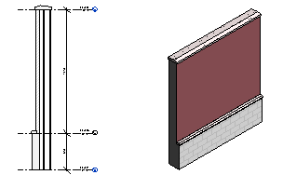
TOPIC 02 · WALLS
Stacked Walls
• A stacked wall is composed of 2 or more subwalls stacked on top of each other.
• Subwalls can have different thicknesses at different heights.
• All subwalls are attached and their geometry is joined.
Autodesk Revit Architecture Masterclass · C508
© 2026 Tertiary Infotech Academy Pte Ltd
49

Slide 50
TOPIC 02 · OPTIONS BAR
Basic Wall Placement Options
Level
The base constraint — in 3D views you can choose any level, including non-storey levels.
Height
The top constraint level, or an Unconnected height value.
1
2
Location Line
Which vertical plane follows your cursor: centerline, core, or a face.
Chain
Draw a connected series of wall segments end to end.
3
4
Offset
Place the wall's location line at a distance from the cursor or picked line.
Join Status
Allow butt joins where walls meet, or Disallow to keep them separate.
5
6
Autodesk Revit Architecture Masterclass · C508
© 2026 Tertiary Infotech Academy Pte Ltd
50

Slide 51
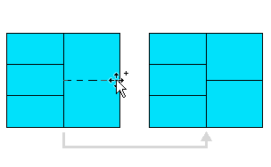
TOPIC 02 · WALLS
Curtain Walls
• A curtain wall is placed like any wall — just pick a curtain wall type in the Type Selector.
• After placement, divide the wall with curtain grids, then place mullions on the grid lines.
• Select a panel (Tab to cycle), then swap its type — including doors and walls embedded in panels.
• Architecture ▸ Build ▸ Curtain Grid · Add/Remove Segments to customise the layout.
Autodesk Revit Architecture Masterclass · C508
© 2026 Tertiary Infotech Academy Pte Ltd
51

Slide 52
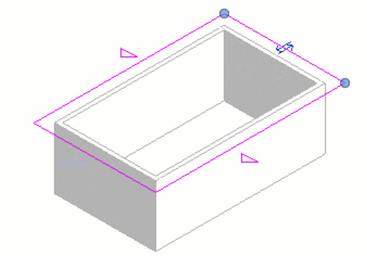
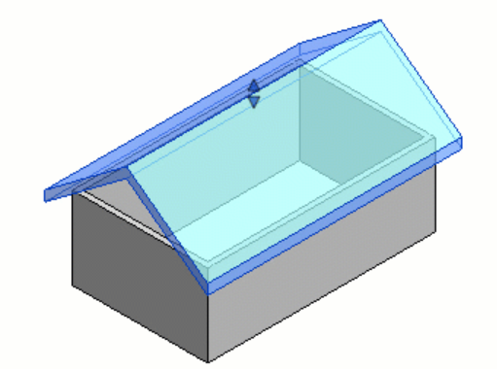
TOPIC 02 · ROOFS (Architecture ▸ Build ▸ Roof ▸ Roof by Footprint)
Roof by Footprint
Sketch: a closed loop with slope-defining lines (△ marker)
Result: the finished footprint roof in 3D
Autodesk Revit Architecture Masterclass · C508
© 2026 Tertiary Infotech Academy Pte Ltd
52

Slide 53
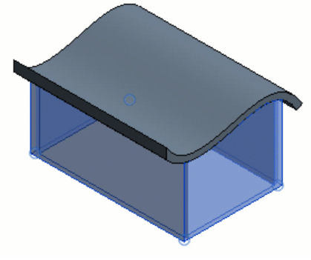
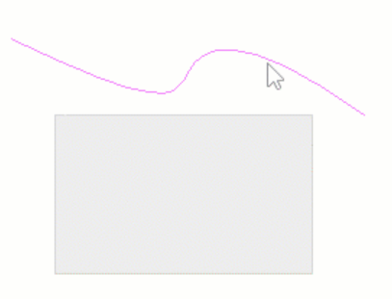
TOPIC 02 · ROOFS (Architecture ▸ Build ▸ Roof ▸ Roof by Extrusion)
Roof by Extrusion
Sketch the profile as an open loop in an elevation view
The profile extrudes into the roof; attach walls afterwards
Autodesk Revit Architecture Masterclass · C508
© 2026 Tertiary Infotech Academy Pte Ltd
53

Slide 54
TOPIC 02 · HORIZONTAL ELEMENTS
Ceilings, Floors and Openings
Ceiling
In a ceiling plan: Automatic Ceiling fills walls that form a closed loop, or sketch the boundary.
Floor
Pick walls or sketch a closed-loop profile; extra closed loops inside become openings.
1
2
Opening — By Face / Vertical
Cut perpendicular to a roof/floor/ceiling face, or vertically to a level.
Shaft opening
Cuts through the entire height — every floor, roof and ceiling it crosses, on all levels.
3
4
Dormer opening
Join the dormer roof to the main roof, then pick the boundary edges to cut the opening.
Stairs
Assemble runs, landings, supports and railings in stair assembly edit mode — plan or 3D.
5
6
Autodesk Revit Architecture Masterclass · C508
© 2026 Tertiary Infotech Academy Pte Ltd
54

Slide 55
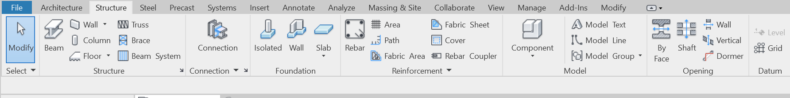
TOPIC 02 · STRUCTURE
Add Columns to Grids
• Structure ▸ Structure ▸ Structural Column ▸ Multiple ▸ At Grids.
• Select grid lines — a column previews at every intersection.
• Spacebar rotates all the columns being placed; Ctrl-drag to add more intersections.
• Click Finish to create all the columns in one action.
Autodesk Revit Architecture Masterclass · C508
© 2026 Tertiary Infotech Academy Pte Ltd
55

Slide 56
TOPIC 02 · HANDS-ON
Create Walls
LAB 5
Maps to: create part lists for modeling using Revit (LO2)
Work on different levels to add the exterior walls, interior partition walls and a corridor to the project, then tidy the joins with the Trim/Extend tool.
YOU'LL BUILD
TOOLCHAIN
DONE WHEN
A building shell with exterior walls, interior walls and a corridor opening on the lower level.
Revit · Wall: Architectural · Trim/Extend
The lower level shows a closed exterior shell with interior partitions and a corridor; walls meet cleanly with no gaps or crossing lines. Compare with ModelCreation.rvt in the lab folder.
Autodesk Revit Architecture Masterclass · C508
© 2026 Tertiary Infotech Academy Pte Ltd
56

Slide 57
LAB 5 · PROCEDURE
Create Walls — Steps 1–3
Open the lower-level floor plan and start the architectural Wall tool.
1
Architecture ▸ Build ▸ Wall ▸ Wall: Architectural
Pick the wall type and set base/top constraints in the Properties palette.
2
Type Selector ▸ Basic Wall: Generic 200mm ▸ Top Constraint: Up to level 02
On the Options Bar set the Location Line and enable Chain, then draw the exterior walls clockwise.
3
Options Bar ▸ Location Line: Wall Centerline ▸ Chain ✓
Autodesk Revit Architecture Masterclass · C508
© 2026 Tertiary Infotech Academy Pte Ltd
57

Slide 58
LAB 5 · PROCEDURE
Create Walls — Steps 4–6
Add the interior partition walls with a thinner wall type.
4
Type Selector ▸ Basic Wall: Interior 135mm Partition
Create the corridor by trimming the partition walls to form the opening.
5
Modify ▸ Trim/Extend to Corner ▸ click the two walls to keep
Check the shell in 3D and correct any wall join problems.
6
Default 3D View ▸ inspect ▸ Modify ▸ Wall Joins if needed
Autodesk Revit Architecture Masterclass · C508
© 2026 Tertiary Infotech Academy Pte Ltd
58

Slide 59
LAB 5 · VERIFY
Create Walls
✅ Expected result
The lower level shows a closed exterior shell with interior partitions and a corridor; walls meet cleanly with no gaps or crossing lines. Compare with ModelCreation.rvt in the lab folder.
IF IT DOESN'T WORK
Tool is greyed out
Warning about closed loops
Can't select an element
Check the active view type — many tools only work in a plan, elevation or 3D view.
Open the sketch again and use Trim/Extend until the boundary is one closed loop.
Hover and press Tab to cycle the selection, and check the selection filters at the status bar.
Autodesk Revit Architecture Masterclass · C508
© 2026 Tertiary Infotech Academy Pte Ltd
59

Slide 60
TOPIC 02 · HANDS-ON
Place Doors and Windows
LAB 6
Maps to: create part lists for modeling using Revit (LO2)
Load door families into the project, then place interior and exterior doors and windows — flipping swing and orientation with the Spacebar and flip controls.
YOU'LL BUILD
TOOLCHAIN
DONE WHEN
A model with doors and windows placed and correctly oriented in the walls, each opening cut automatically.
Revit · Door tool · Window tool · Load Family
Every door and window sits in a wall with its opening cut automatically, tags show sequential numbers, and all swings open the intended way.
Autodesk Revit Architecture Masterclass · C508
© 2026 Tertiary Infotech Academy Pte Ltd
60

Slide 61
LAB 6 · PROCEDURE
Place Doors and Windows — Steps 1–3
Open the entry-level floor plan and start the Door tool.
1
Architecture ▸ Build ▸ Door
Load additional door families from the library.
2
Modify | Place Door ▸ Mode ▸ Load Family ▸ Doors ▸ choose an entrance door
Enable tagging on placement so each door is numbered automatically.
3
Modify | Place Door ▸ Tag ▸ Tag on Placement
Autodesk Revit Architecture Masterclass · C508
© 2026 Tertiary Infotech Academy Pte Ltd
61

Slide 62
LAB 6 · PROCEDURE
Place Doors and Windows — Steps 4–6
Hover over a wall, press Spacebar to flip the swing, then click to place the door.
4
Spacebar to flip ▸ click to place
Place windows on the exterior walls with the Window tool.
5
Architecture ▸ Build ▸ Window ▸ click the exterior walls
Fix any wrongly-placed component with the blue flip-control arrows.
6
Select the door/window ▸ click the flip arrows
Autodesk Revit Architecture Masterclass · C508
© 2026 Tertiary Infotech Academy Pte Ltd
62

Slide 63
LAB 6 · VERIFY
Place Doors and Windows
✅ Expected result
Every door and window sits in a wall with its opening cut automatically, tags show sequential numbers, and all swings open the intended way.
IF IT DOESN'T WORK
Tool is greyed out
Warning about closed loops
Can't select an element
Check the active view type — many tools only work in a plan, elevation or 3D view.
Open the sketch again and use Trim/Extend until the boundary is one closed loop.
Hover and press Tab to cycle the selection, and check the selection filters at the status bar.
Autodesk Revit Architecture Masterclass · C508
© 2026 Tertiary Infotech Academy Pte Ltd
63

Slide 64
TOPIC 02 · HANDS-ON
Create a Floor and a Roof by Footprint
LAB 7
Maps to: create part lists for modeling using Revit (LO2)
Create a mezzanine floor by sketching its boundary, edit the sketch with Align and Trim into a closed loop, then complete the envelope with a footprint roof whose slopes you define.
YOU'LL BUILD
TOOLCHAIN
DONE WHEN
A mezzanine floor in the store-room area and a sloped roof closing the building envelope.
Revit · Floor: Architectural · Roof by Footprint · Shaft Opening
The mezzanine floor appears with a clean shaft opening, and the 3D view shows a sloped roof sitting on the footprint — no warnings about open loops.
Autodesk Revit Architecture Masterclass · C508
© 2026 Tertiary Infotech Academy Pte Ltd
64

Slide 65
LAB 7 · PROCEDURE
Create a Floor and a Roof by Footprint — Steps 1–3
Open the upper-level plan and start the architectural Floor tool.
1
Architecture ▸ Build ▸ Floor ▸ Floor: Architectural
Pick the bounding walls, then switch to Line to close the open edge.
2
Modify | Create Floor Boundary ▸ Pick Walls ▸ Draw ▸ Line
Use Align and Trim to make the sketch one closed loop, then finish.
3
Modify ▸ Align / Trim ▸ ✓ Finish Edit Mode
Autodesk Revit Architecture Masterclass · C508
© 2026 Tertiary Infotech Academy Pte Ltd
65

Slide 66
LAB 7 · PROCEDURE
Create a Floor and a Roof by Footprint — Steps 4–6
Cut a stair opening through the new floor with the Shaft tool.
4
Architecture ▸ Opening ▸ Shaft ▸ sketch the opening ▸ Finish
Create the roof from the building footprint on the roof level.
5
Architecture ▸ Build ▸ Roof ▸ Roof by Footprint ▸ Pick Walls
Set which boundary lines define a slope, then finish and view in 3D.
6
Select a line ▸ Properties ▸ Defines Roof Slope ✓ ▸ ✓ Finish
Autodesk Revit Architecture Masterclass · C508
© 2026 Tertiary Infotech Academy Pte Ltd
66

Slide 67
LAB 7 · VERIFY
Create a Floor and a Roof by Footprint
✅ Expected result
The mezzanine floor appears with a clean shaft opening, and the 3D view shows a sloped roof sitting on the footprint — no warnings about open loops.
IF IT DOESN'T WORK
Tool is greyed out
Warning about closed loops
Can't select an element
Check the active view type — many tools only work in a plan, elevation or 3D view.
Open the sketch again and use Trim/Extend until the boundary is one closed loop.
Hover and press Tab to cycle the selection, and check the selection filters at the status bar.
Autodesk Revit Architecture Masterclass · C508
© 2026 Tertiary Infotech Academy Pte Ltd
67

Slide 68
TOPIC 02 · HANDS-ON
Create Stairs and Railings
LAB 8
Maps to: create part lists for modeling using Revit (LO2)
Complete the interior by adding a staircase from the store floor to the mezzanine, then modify the mezzanine railing and change its type to a pipe railing.
YOU'LL BUILD
TOOLCHAIN
DONE WHEN
A staircase connecting the store floor to the mezzanine, with a matching pipe railing on the mezzanine edge.
Revit · Stair tool · Railing tool
The 3D view shows a complete stair with railings from the store floor to the mezzanine, and the mezzanine edge railing is the pipe type.
Autodesk Revit Architecture Masterclass · C508
© 2026 Tertiary Infotech Academy Pte Ltd
68

Slide 69
LAB 8 · PROCEDURE
Create Stairs and Railings — Steps 1–3
Open the lower-level plan and start the Stair tool.
1
Architecture ▸ Circulation ▸ Stair
Set the base and top levels for the run in the Properties palette.
2
Properties ▸ Base Level: 01 ▸ Top Level: Mezzanine
Choose the railing type to generate with the stair.
3
Modify | Create Stair ▸ Tools ▸ Railing ▸ pick a type
Autodesk Revit Architecture Masterclass · C508
© 2026 Tertiary Infotech Academy Pte Ltd
69

Slide 70
LAB 8 · PROCEDURE
Create Stairs and Railings — Steps 4–6
Draw the run: click the start point, move up-screen, click the end point.
4
Components ▸ Run ▸ Straight ▸ click start ▸ click end
Finish the stair and inspect it in 3D.
5
✓ Finish Edit Mode ▸ Default 3D View
Select the mezzanine railing and change it to a pipe railing type.
6
Select railing ▸ Type Selector ▸ Railing: Pipe
Autodesk Revit Architecture Masterclass · C508
© 2026 Tertiary Infotech Academy Pte Ltd
70

Slide 71
LAB 8 · VERIFY
Create Stairs and Railings
✅ Expected result
The 3D view shows a complete stair with railings from the store floor to the mezzanine, and the mezzanine edge railing is the pipe type.
IF IT DOESN'T WORK
Tool is greyed out
Warning about closed loops
Can't select an element
Check the active view type — many tools only work in a plan, elevation or 3D view.
Open the sketch again and use Trim/Extend until the boundary is one closed loop.
Hover and press Tab to cycle the selection, and check the selection filters at the status bar.
Autodesk Revit Architecture Masterclass · C508
© 2026 Tertiary Infotech Academy Pte Ltd
71

Slide 72
TOPIC RECAP
Recap — Part Lists for Modeling in Revit
• You can now: create part lists for modeling using Revit (Lab 5: Create Walls)
• You can now: create part lists for modeling using Revit (Lab 6: Place Doors and Windows)
• You can now: create part lists for modeling using Revit (Lab 7: Create a Floor and a Roof by Footprint)
• You can now: create part lists for modeling using Revit (Lab 8: Create Stairs and Railings)
Autodesk Revit Architecture Masterclass · C508
© 2026 Tertiary Infotech Academy Pte Ltd
72

Slide 73
03
TOPIC 03
Model Documentation
Dimensions · Rooms · Area plans · Furniture plans · Color fill legends · Dependent views · Object styles · Callout & section views
Autodesk Revit Architecture Masterclass · C508
© 2026 Tertiary Infotech Academy Pte Ltd
73

Slide 74
TOPIC 03 · KEY CONCEPTS
Key Concepts — Model Documentation
Dimensions
Temporary dimensions appear while placing; permanent dimensions (aligned, linear, angular, radial, arc length) document the design and print on sheets.
Rooms
Rooms are subdivisions bounded by walls, floors, roofs and ceilings; Revit computes perimeter, area and volume, and room separation lines subdivide open space.
1
2
Area plans
Area schemes and boundary lines measure gross/rentable areas per level, created from the Room & Area panel.
Color fill legends
Color schemes paint rooms or areas in plan views; the legend provides the key and is edited from the Scheme panel.
3
4
Views for a purpose
Duplicate (with detailing / as dependent) to make furniture plans, callouts of wall details and building sections.
Object styles & visibility
Object Styles set project-wide line weight, colour, pattern and material per category; Visibility/Graphics overrides them per view.
5
6
Autodesk Revit Architecture Masterclass · C508
© 2026 Tertiary Infotech Academy Pte Ltd
74

Slide 75
WHAT YOU'LL DO
Hands-On Labs — Model Documentation
Lab 9
Lab 10
Lab 11
• Add Dimensions to the Model
• Create Rooms, an Area Plan and a Color Fill Legend
• Create Section, Callout and Dependent Views
Autodesk Revit Architecture Masterclass · C508
© 2026 Tertiary Infotech Academy Pte Ltd
75

Slide 76
TOPIC 03 · ANNOTATE ▸ DIMENSION
Five Permanent Dimension Types
Aligned
Between parallel references or points — walls, faces, core, with Intersecting Grids and Openings options.
Linear
Between points, locked to the view's horizontal/vertical axis; Spacebar aligns the axis.
1
2
Angular
Between references sharing a common intersection — pick two non-parallel elements.
Radial
Click an arc, then place — the radius of curved elements.
3
4
Arc Length
Pick the radial point, then the arc ends — the length of a curved wall.
Temporary vs permanent
Temporary dimensions appear while placing and vanish; permanent ones print on sheets.
5
6
Autodesk Revit Architecture Masterclass · C508
© 2026 Tertiary Infotech Academy Pte Ltd
76

Slide 77
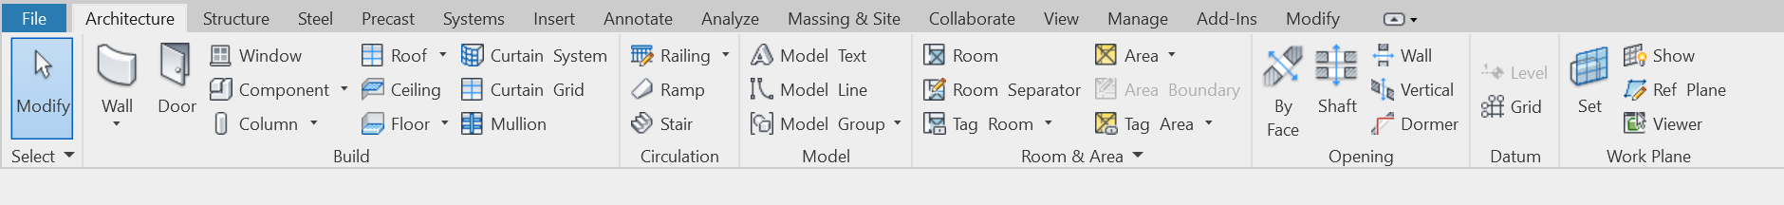
TOPIC 03 · ARCHITECTURE ▸ ROOM & AREA
Rooms — Create, Edit, Delete
• A room is a subdivision of space bounded by room-bounding elements: walls, floors, roofs and ceilings.
• Revit computes each room's perimeter, area and volume, updating as bounding elements move.
• Room separation lines subdivide open space; the Room Bounding parameter can be toggled per element.
• Delete rooms from a room schedule: Isolate not-placed rows, select them and Delete.
Autodesk Revit Architecture Masterclass · C508
© 2026 Tertiary Infotech Academy Pte Ltd
77

Slide 78
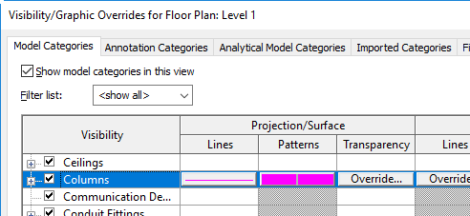
TOPIC 03 · VIEWS FOR A PURPOSE
Furniture Plans & View Duplication
• Duplicate copies the model geometry only; Duplicate with Detailing also copies annotations and detail items.
• Duplicate as Dependent keeps the copy synchronised with the primary view — crop it to one wing or sheet area.
• Purpose-made views: a furniture layout half-toned on the RCP, or a furniture plan with room names on a half-toned floor plan.
Autodesk Revit Architecture Masterclass · C508
© 2026 Tertiary Infotech Academy Pte Ltd
78

Slide 79
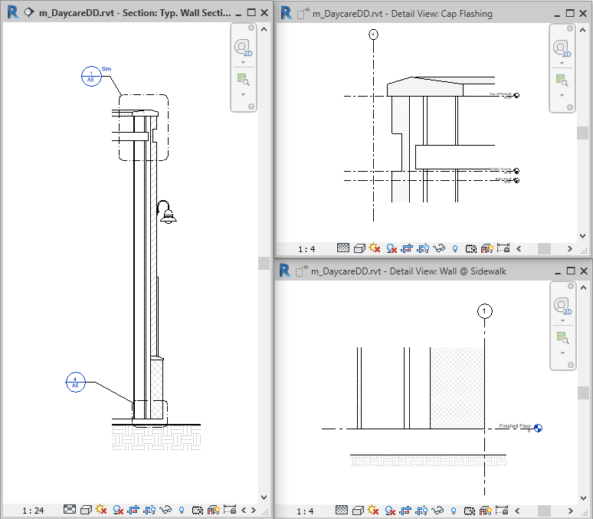
TOPIC 03 · VIEW ▸ CREATE
Callout and Section Views
• A callout shows an enlarged part of the parent view — add detail there without cluttering the parent.
• The callout tag links to the callout view; deleting the parent view deletes the callout.
• Sections cut through the model: View ▸ Create ▸ Section, drag through the model, then resize the crop region.
• Double-click the section head (or use the Project Browser) to open the section view.
Autodesk Revit Architecture Masterclass · C508
© 2026 Tertiary Infotech Academy Pte Ltd
79

Slide 80
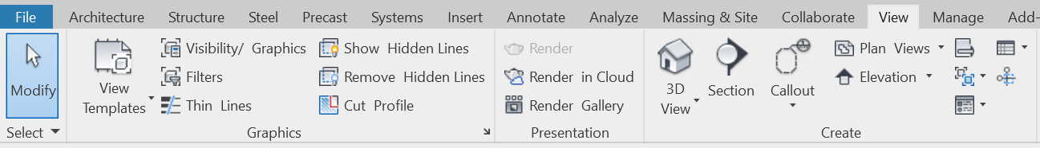
TOPIC 03 · GRAPHIC CONTROL
Object Styles vs Visibility/Graphics
• Object Styles (Manage ▸ Settings) set project-wide line weight, colour, pattern and material per category.
• Visibility/Graphics (VG) overrides those settings per view; element overrides go one step further.
• If a category cell is blank in VG, the element displays as specified in Object Styles.
• This is what makes purpose-specific views possible without duplicating the model.
Autodesk Revit Architecture Masterclass · C508
© 2026 Tertiary Infotech Academy Pte Ltd
80

Slide 81
TOPIC 03 · HANDS-ON
Add Dimensions to the Model
LAB 9
Maps to: assist in design prototyping and create design documentation (LO3)
Dimension the footprint of the main building: overall widths, then aligned dimension strings that automatically pick up grid intersections and window openings on the exterior walls.
YOU'LL BUILD
TOOLCHAIN
DONE WHEN
A dimensioned floor plan documenting the building footprint, grids and openings.
Revit · Aligned Dimension · Linear Dimension
The plan shows an overall dimension plus a string that lists every grid intersection and window centre along the exterior wall — values update if a window is moved.
Autodesk Revit Architecture Masterclass · C508
© 2026 Tertiary Infotech Academy Pte Ltd
81

Slide 82
LAB 9 · PROCEDURE
Add Dimensions to the Model — Steps 1–3
Open the entry-level floor plan of LittleHouse.rvt.
1
Project Browser ▸ Floor Plans ▸ 01 - Entry Level
Start the Aligned dimension tool and set the snap preference.
2
Annotate ▸ Dimension ▸ Aligned ▸ Options Bar ▸ Prefer: Wall faces
Dimension the overall width: click the two outer wall faces, then click to place the line.
3
Click wall face ▸ click opposite face ▸ click to place
Autodesk Revit Architecture Masterclass · C508
© 2026 Tertiary Infotech Academy Pte Ltd
82

Slide 83
LAB 9 · PROCEDURE
Add Dimensions to the Model — Steps 4–6
Dimension the exterior wall with grid intersections picked up automatically.
4
Options Bar ▸ Pick: Entire Walls ▸ Options ▸ Intersecting Grids ✓
Add the window openings to the same dimension string.
5
Options ▸ Openings: Centers ✓ ▸ click the exterior wall
Place a linear dimension between two points and align it with the Spacebar.
6
Annotate ▸ Dimension ▸ Linear ▸ pick two points ▸ Spacebar
Autodesk Revit Architecture Masterclass · C508
© 2026 Tertiary Infotech Academy Pte Ltd
83

Slide 84
LAB 9 · VERIFY
Add Dimensions to the Model
✅ Expected result
The plan shows an overall dimension plus a string that lists every grid intersection and window centre along the exterior wall — values update if a window is moved.
IF IT DOESN'T WORK
Tool is greyed out
Warning about closed loops
Can't select an element
Check the active view type — many tools only work in a plan, elevation or 3D view.
Open the sketch again and use Trim/Extend until the boundary is one closed loop.
Hover and press Tab to cycle the selection, and check the selection filters at the status bar.
Autodesk Revit Architecture Masterclass · C508
© 2026 Tertiary Infotech Academy Pte Ltd
84

Slide 85
TOPIC 03 · HANDS-ON
Create Rooms, an Area Plan and a Color Fill Legend
LAB 10
Maps to: assist in design prototyping and create design documentation (LO3)
Subdivide the model into rooms, create an area plan for the level, then colour the plan with a colour scheme and place its legend as the key.
YOU'LL BUILD
TOOLCHAIN
DONE WHEN
A room-tagged plan, a gross-area plan and a colour-filled plan with legend.
Revit · Room tool · Area Plan · Color Fill Legend
Every space carries a named room tag, the area plan reports the level's areas, and the plan is colour-filled with a legend that matches the scheme.
Autodesk Revit Architecture Masterclass · C508
© 2026 Tertiary Infotech Academy Pte Ltd
85

Slide 86
LAB 10 · PROCEDURE
Create Rooms, an Area Plan and a Color Fill Legend — Steps 1–3
Place rooms in every enclosed space on the entry level.
1
Architecture ▸ Room & Area ▸ Room ▸ click inside each space
Rename the rooms by editing their tags.
2
Double-click a room tag ▸ type the name ▸ Enter
Create an area plan for the entry level, letting Revit add the boundary lines.
3
Architecture ▸ Room & Area ▸ Area ▸ Area Plan ▸ Level 01 ▸ Yes
Autodesk Revit Architecture Masterclass · C508
© 2026 Tertiary Infotech Academy Pte Ltd
86

Slide 87
LAB 10 · PROCEDURE
Create Rooms, an Area Plan and a Color Fill Legend — Steps 4–6
Place a colour fill legend beside the plan.
4
Annotate ▸ Color Fill ▸ Legend ▸ click in the drawing area
Choose the space type and colour scheme for the legend.
5
Choose Space Type: Rooms ▸ Color Scheme: Name ▸ OK
Edit the scheme to colour by department or by name.
6
Select legend ▸ Edit Scheme ▸ pick a scheme ▸ OK
Autodesk Revit Architecture Masterclass · C508
© 2026 Tertiary Infotech Academy Pte Ltd
87

Slide 88
LAB 10 · VERIFY
Create Rooms, an Area Plan and a Color Fill Legend
✅ Expected result
Every space carries a named room tag, the area plan reports the level's areas, and the plan is colour-filled with a legend that matches the scheme.
IF IT DOESN'T WORK
Tool is greyed out
Warning about closed loops
Can't select an element
Check the active view type — many tools only work in a plan, elevation or 3D view.
Open the sketch again and use Trim/Extend until the boundary is one closed loop.
Hover and press Tab to cycle the selection, and check the selection filters at the status bar.
Autodesk Revit Architecture Masterclass · C508
© 2026 Tertiary Infotech Academy Pte Ltd
88

Slide 89
TOPIC 03 · HANDS-ON
Create Section, Callout and Dependent Views
LAB 11
Maps to: assist in design prototyping and create design documentation (LO3)
Create a building section through the model, a callout view of the exterior wall, and a detail callout of the parapet; then duplicate a plan as a dependent view and as a furniture plan.
YOU'LL BUILD
TOOLCHAIN
DONE WHEN
A section view, wall-section callout, detail callout and purpose-made duplicate views.
Revit · Section tool · Callout tool · Duplicate View
The Project Browser shows the section, the two callouts and the dependent/furniture views; each callout head links to its enlarged view.
Autodesk Revit Architecture Masterclass · C508
© 2026 Tertiary Infotech Academy Pte Ltd
89

Slide 90
LAB 11 · PROCEDURE
Create Section, Callout and Dependent Views — Steps 1–3
Draw a building section through the model from the entry-level plan.
1
View ▸ Create ▸ Section ▸ click start ▸ click end
Resize the crop region and flip the view direction if needed, then open the section.
2
Drag the blue controls ▸ double-click the section head
Create a wall-section callout of the exterior wall in the section view.
3
View ▸ Create ▸ Callout ▸ Rectangle ▸ drag around the wall
Autodesk Revit Architecture Masterclass · C508
© 2026 Tertiary Infotech Academy Pte Ltd
90

Slide 91
LAB 11 · PROCEDURE
Create Section, Callout and Dependent Views — Steps 4–6
Create a detail callout of the parapet inside the wall section.
4
View ▸ Create ▸ Callout ▸ Detail ▸ drag around the parapet
Duplicate the entry-level plan as a dependent view and crop it to one wing.
5
Project Browser ▸ right-click plan ▸ Duplicate View ▸ Duplicate as Dependent
Duplicate with detailing to make a furniture plan, half-toning the model categories.
6
Duplicate with Detailing ▸ Visibility/Graphics ▸ Halftone
Autodesk Revit Architecture Masterclass · C508
© 2026 Tertiary Infotech Academy Pte Ltd
91

Slide 92
LAB 11 · VERIFY
Create Section, Callout and Dependent Views
✅ Expected result
The Project Browser shows the section, the two callouts and the dependent/furniture views; each callout head links to its enlarged view.
IF IT DOESN'T WORK
Tool is greyed out
Warning about closed loops
Can't select an element
Check the active view type — many tools only work in a plan, elevation or 3D view.
Open the sketch again and use Trim/Extend until the boundary is one closed loop.
Hover and press Tab to cycle the selection, and check the selection filters at the status bar.
Autodesk Revit Architecture Masterclass · C508
© 2026 Tertiary Infotech Academy Pte Ltd
92

Slide 93
TOPIC RECAP
Recap — Model Documentation
• You can now: assist in design prototyping and create design documentation (Lab 9: Add Dimensions to the Model)
• You can now: assist in design prototyping and create design documentation (Lab 10: Create Rooms, an Area Plan and a Color Fill Legend)
• You can now: assist in design prototyping and create design documentation (Lab 11: Create Section, Callout and Dependent Views)
Autodesk Revit Architecture Masterclass · C508
© 2026 Tertiary Infotech Academy Pte Ltd
93

Slide 94
04
TOPIC 04
Design Specification
System, loadable & in-place families · Type catalogs · Detail components · Schedules · Drawing sheets · Worksharing · CAD links · Project management
Autodesk Revit Architecture Masterclass · C508
© 2026 Tertiary Infotech Academy Pte Ltd
94

Slide 95
TOPIC 04 · KEY CONCEPTS
Key Concepts — Design Specification
Three kinds of families
System families (walls, roofs, floors), loadable families (doors, windows, furniture, title blocks — RFA files) and in-place families for one-off elements.
Type catalogs
Load only the family types you need to keep the project small and the Type Selector short.
1
2
Schedules
Schedule/Quantities lists building components; choose fields, filter, sort, group and format — the schedule is live model data.
Drawing sheets
A construction document set is composed of sheets; each placed view becomes a viewport with a title block, then print or export to PDF.
3
4
Worksharing
Team members share a central model and work simultaneously in local copies organised by worksets.
Link & import CAD
Link or import DWG/DXF data, acquire or publish shared coordinates, audit the model and transfer project standards.
5
6
Autodesk Revit Architecture Masterclass · C508
© 2026 Tertiary Infotech Academy Pte Ltd
95

Slide 96
WHAT YOU'LL DO
Hands-On Labs — Design Specification
Lab 12
—
—
• Families, Tags, a Schedule and Drawing Sheets
• —
• —
Autodesk Revit Architecture Masterclass · C508
© 2026 Tertiary Infotech Academy Pte Ltd
96

Slide 97
TOPIC 04 · FAMILIES
The Three Kinds of Revit Families
System families
Loadable families
In-place families
• Walls, roofs, floors, ducts, pipes
• Predefined in Revit — not loaded from files
• Include settings: levels, grids, sheets, viewports
• Doors, windows, furniture, fixtures
• Symbols and title blocks
• RFA files — the most commonly created/edited
• Unique, one-off elements
• Created inside the project
• Reference other project geometry and resize with it
Autodesk Revit Architecture Masterclass · C508
© 2026 Tertiary Infotech Academy Pte Ltd
97

Slide 98
TOPIC 04 · RFA WORKFLOW
Loading and Managing Families
Load a family
Insert ▸ Load from Library ▸ Load Family — preview thumbnails, then Open.
Type catalog
For large families, load only the types you need — keeps the project small and the Type Selector short.
1
2
Save a family
File ▸ Save As ▸ Library ▸ Family, or right-click a family in the Project Browser ▸ Save.
Detail components
2D line-based families placed in detail/drafting views — Annotate ▸ Detail Component.
3
4
Autodesk Revit Architecture Masterclass · C508
© 2026 Tertiary Infotech Academy Pte Ltd
98

Slide 99
TOPIC 04 · SCHEDULE/QUANTITIES
Create a Schedule
1
2
3
4
5
New schedule
Pick category
Choose fields
Filter & sort
Format
View ▸ Schedules
e.g. Doors
Mark, Type, Width…
Sorting/Grouping tab
Headers, appearance
LIVE DATA
A schedule is a live view of the model — edit a value in the schedule and the model changes; multi-category schedules can only include loadable families.
Autodesk Revit Architecture Masterclass · C508
© 2026 Tertiary Infotech Academy Pte Ltd
99

Slide 100
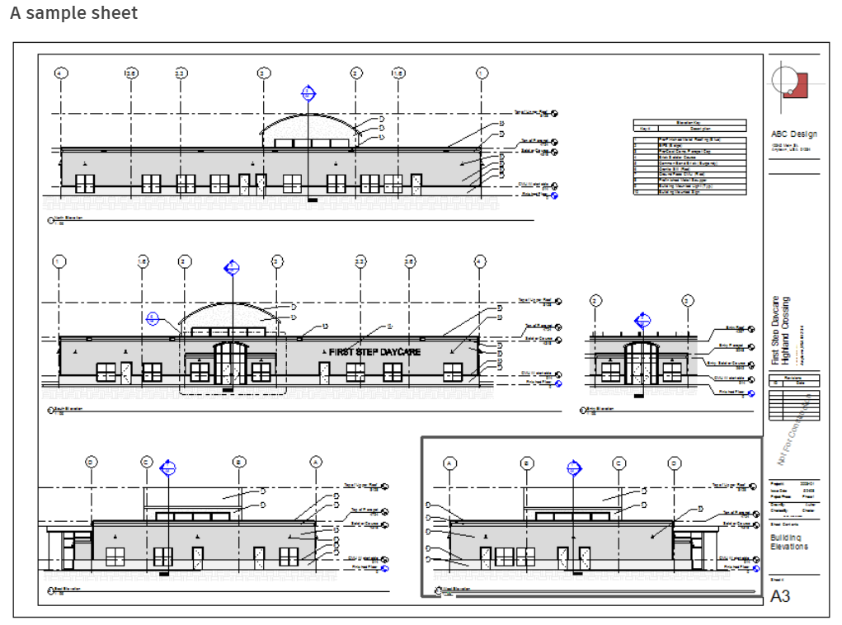
TOPIC 04 · DOCUMENT SET
Drawing Sheets
• A construction document set consists of sheets — View ▸ Sheet Composition ▸ Sheet.
• Drag views and schedules from the Project Browser onto the sheet; each becomes a viewport.
• Parts of a sheet: the sheet itself, project views, schedules and the title block.
• Print with File ▸ Print, or choose a PDF driver to issue a single PDF of selected sheets.
Autodesk Revit Architecture Masterclass · C508
© 2026 Tertiary Infotech Academy Pte Ltd
100

Slide 101
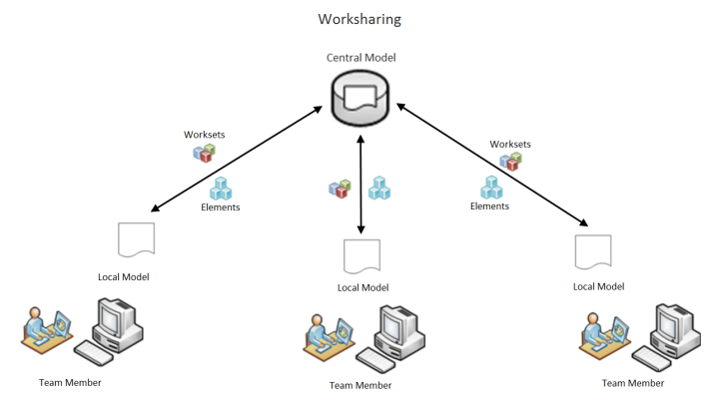
TOPIC 04 · COLLABORATION
Worksharing — Team on One Model
• Worksharing lets multiple team members work on the same project model at the same time.
• Everyone shares a central model and works in a local copy, organised by worksets.
• Enable it via Collaborate ▸ Manage Collaboration ▸ Worksets, then Save As to create the central model.
• Default worksets: Shared Levels and Grids, and Workset1 — rename or add as the team needs.
Autodesk Revit Architecture Masterclass · C508
© 2026 Tertiary Infotech Academy Pte Ltd
101

Slide 102
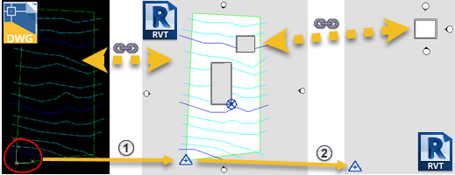
TOPIC 04 · PROJECT MANAGEMENT
Link CAD, Coordinates & Project Hygiene
• Link CAD keeps a live reference to a DWG; Import CAD brings the vector data in.
• Acquire Coordinates from a linked site model; Publish Coordinates pushes them to linked building models.
• Audit (File ▸ Open ▸ Audit) scans and fixes corrupt elements in the model.
• Transfer Project Standards copies types and settings from one project to another (Overwrite / New Only).
Autodesk Revit Architecture Masterclass · C508
© 2026 Tertiary Infotech Academy Pte Ltd
102

Slide 103
TOPIC 04 · HANDS-ON
Families, Tags, a Schedule and Drawing Sheets
LAB 12
Maps to: produce design specification using Revit (LO4)
Load the door, window and wall tag families supplied in the lab folder, tag the model, build a door schedule, then compose a titled drawing sheet with plan, section and schedule — the deliverable construction document.
YOU'LL BUILD
TOOLCHAIN
DONE WHEN
A construction-document sheet with title block carrying the plan, a section, tags and a live door schedule.
Revit · Load Family · Tag by Category · Schedule/Quantities · Sheet
Sheet A101 shows the plan, section and door schedule inside the title block; the schedule updates live when a door type changes, and the exported PDF matches the sheet.
Autodesk Revit Architecture Masterclass · C508
© 2026 Tertiary Infotech Academy Pte Ltd
103

Slide 104
LAB 12 · PROCEDURE
Families, Tags, a Schedule and Drawing Sheets — Steps 1–4
Load the three tag families supplied in this lab's folder.
1
Insert ▸ Load from Library ▸ Load Family ▸ select the 3 RFA files
Tag the doors, windows and walls in the entry-level plan.
2
Annotate ▸ Tag ▸ Tag by Category ▸ click each element
Create a door schedule and choose its fields.
3
View ▸ Create ▸ Schedules ▸ Schedule/Quantities ▸ Doors ▸ add Mark, Type, Width, Height
Sort the schedule by Mark and format the headers.
4
Schedule Properties ▸ Sorting/Grouping ▸ Mark ▸ Formatting
Autodesk Revit Architecture Masterclass · C508
© 2026 Tertiary Infotech Academy Pte Ltd
104

Slide 105
LAB 12 · PROCEDURE
Families, Tags, a Schedule and Drawing Sheets — Steps 5–7
Create a sheet from a title block and rename it.
5
View ▸ Sheet Composition ▸ Sheet ▸ A1 metric ▸ rename A101 - Plans
Drag the plan, the section and the schedule onto the sheet and arrange the viewports.
6
Drag views from the Project Browser onto the sheet
Print or export the sheet to PDF as the issued document.
7
File ▸ Print ▸ PDF driver ▸ Selected views/sheets ▸ OK
Autodesk Revit Architecture Masterclass · C508
© 2026 Tertiary Infotech Academy Pte Ltd
105

Slide 106
LAB 12 · VERIFY
Families, Tags, a Schedule and Drawing Sheets
✅ Expected result
Sheet A101 shows the plan, section and door schedule inside the title block; the schedule updates live when a door type changes, and the exported PDF matches the sheet.
IF IT DOESN'T WORK
Tool is greyed out
Warning about closed loops
Can't select an element
Check the active view type — many tools only work in a plan, elevation or 3D view.
Open the sketch again and use Trim/Extend until the boundary is one closed loop.
Hover and press Tab to cycle the selection, and check the selection filters at the status bar.
Autodesk Revit Architecture Masterclass · C508
© 2026 Tertiary Infotech Academy Pte Ltd
106

Slide 107
TOPIC RECAP
Recap — Design Specification
• You can now: produce design specification using Revit (Lab 12: Families, Tags, a Schedule and Drawing Sheets)
Autodesk Revit Architecture Masterclass · C508
© 2026 Tertiary Infotech Academy Pte Ltd
107

Slide 108
WRAP-UP
Course Summary & Next Steps
Autodesk Revit Architecture Masterclass · C508
© 2026 Tertiary Infotech Academy Pte Ltd
108

Slide 109
COURSE RECAP
What You Achieved
Design modeling
Created projects, levels, terrain, masses, materials and photorealistic renders (Labs 1–4).
Building elements
Modelled walls, doors, windows, floors, roofs, stairs and railings (Labs 5–8).
1
2
Documentation
Dimensioned plans, created rooms, area plans, colour fills, sections and callouts (Labs 9–11).
Specification
Loaded families, tagged elements, built schedules and issued drawing sheets (Lab 12).
3
4
Autodesk Revit Architecture Masterclass · C508
© 2026 Tertiary Infotech Academy Pte Ltd
109

Slide 110
TEST YOURSELF · EXAMS.TERTIARYINFOTECH.COM
Practice Exam
Practice portal
Sharpen your readiness at https://exams.tertiaryinfotech.com
Timed conditions
Attempt the matching Revit practice exam under exam timing.
1
2
Review explanations
Study every explanation — right and wrong answers alike.
Close the loop
Revisit any lab whose topic you miss, then re-take the practice exam.
3
4
Autodesk Revit Architecture Masterclass · C508
© 2026 Tertiary Infotech Academy Pte Ltd
110

Slide 111
YOUR LEARNING PATHWAY
Recommended Next Courses
Application of BIM using Revit
Go deeper into BIM coordination and collaboration.
Technical Drawing with AutoCAD
2D drafting and documentation with AutoCAD.
1
2
Product Design with Fusion 360
Parametric product design and manufacturing.
AutoCAD Civil 3D
Infrastructure design for roads, sites and utilities.
3
4
ACP: Revit Architectural Design
Prepare for the Autodesk Certified Professional exam.
Browse all courses
www.tertiarycourses.com.sg — the full CAD/BIM pathway.
5
6
Autodesk Revit Architecture Masterclass · C508
© 2026 Tertiary Infotech Academy Pte Ltd
111

Slide 112
WE'RE HERE TO HELP
Support & Contact
During and after class
We support you during the course and after it — just reach out.
Email
enquiry@tertiaryinfotech.com
1
2
Telephone
+65 6100 0613
Certificate
Download your certificate of completion from https://lms-tms.tertiaryinfotech.com
3
4
Autodesk Revit Architecture Masterclass · C508
© 2026 Tertiary Infotech Academy Pte Ltd
112

Slide 113
WRAP-UP
Course Feedback
Share your feedback
Complete the course feedback form on the LMS before you leave.
Help us improve
Tell us what worked well and what we should change for the next class.
1
2
Certificate of completion
Issued on the LMS after the course — download it from the portal.
Course portal
Slides, Learner Guide and labs: https://lms-tms.tertiaryinfotech.com
3
4
Autodesk Revit Architecture Masterclass · C508
© 2026 Tertiary Infotech Academy Pte Ltd
113

Slide 114
HAPPY MODELING
Thank You!
You can now model, document and specify an architectural design in Revit — from terrain to issued drawing sheets.
Autodesk Revit Architecture Masterclass · C508
© 2026 Tertiary Infotech Academy Pte Ltd
114

